Slide 1
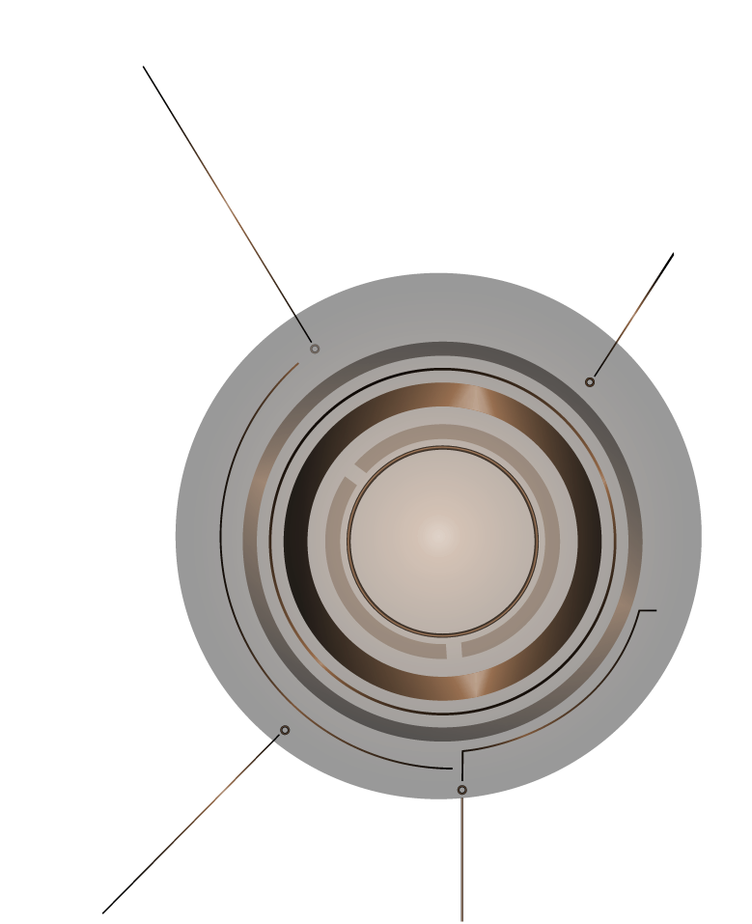
Steam Game Recommender May 7th, 2025
AI
By:
Austin McCormick
Kashif Zafar
Laurie Webb
Notes:
Slide 1 Talking points:
Hi everyone, thank you for being here! We’re excited to present our final project: a Steam Game Recommender System.
Our team includes Austin McCormick, Kashif Zafar, and myself, Laurie Webb.
This is an AI-driven project that blends NLP, machine learning, and a user interface to help players find new games based on what they already love

Slide 2
TABLE OF CONTENTS
01
04
02
05
03
06
Project Goal
TF-IDF + KNN Model
What Problem We Are Solving!
How We Applied and Trained Our Model
Dataset Overview
Kivy User Interface
Steam Dataset- What we Used
Identifying Our UI and Sneak Peak
NLP Preprocessing
Results, Takeaways, and Whats next
Cleaning the Data : Making Text Usable
What We Learned & Where This Could Go
Notes:
1. Steam’s recommendations are based on co-purchases, not content.
Our goal: use NLP and sentiment to understand what makes a game feel right for the player.
We wanted to enable recommendations by mood, playstyle, and vibe.
2. Kaggle dataset: ~50,000+ Steam games
Included: titles, descriptions, tags, ratings, platform info, prices, etc.
Additional metadata via JSON file (merged with CSV)
3. Cleaned description: removed stopwords, punctuation, lowercase
Created clean_description column
Used TF-IDF Vectorization to convert text into meaningful numeric features
Sampled 2,000 games for memory-efficient cosine similarity
4. Used cosine similarity on TF-IDF vectors to find similar games
Input: game title → Output: top 5 similar games
Bonus: Added mood matching based on description + tags!
Optional: filtered by moods like Strategic, Funny, Relaxed, etc.
5. Defined keywords for moods: Intense, Relaxed, Scary, Funny, etc.
Tagged each game using NLP from both description + tags
Now users can ask: “What games are similar to X, but only if I want something relaxing?”
6. Learned practical NLP: TF-IDF, cosine similarity, text preprocessing
Saw the impact of emotion-aware filtering
Potential next steps:
Add Streamlit UI
Use Steam API to pull live game data
Train deeper ML models (e.g. embeddings or BERT)

Slide 3
What Steps We Took
Kickoff:
Demo
Clean Up and Building
Assign Roles, Explore Dataset, Set up GitHub and task boards.
Clean and preprocess game data (descriptions, tags, reviews, Start NLP processing, Review NLP features, Tune NLP models, Build UI
UI Testing and performance tuning, Finalize Notebooks, Prep GitHub README and polish slides

Slide 4

01
Project Goal
This is a content-based recommender system that suggests Steam games based on a user's input — either a game title, genre, mood, or App ID. It uses text analysis and machine learning to recommend similar games and includes a clean, dark-themed interface built with Kivy.

Slide 5
Dataset Overview
0 2
We used two files from the Kaggle : games.csv and games_metadata.json.
We engineered additional columns including tags, mood and combined features.
Merged files using app_id and then cleaned.

Slide 6
NLP Preprocessing
03
Cleaned game titles by removing special characters like TM, R, and non-ASCII symbols
Used keyword matching to assign each game a Genre.
Tagged each game with a mood based on its description (e.g., “relaxing”, “horror”, “intense”).
Combined the tags and description into a single column for use in vectorization.

Slide 7
TF-IF + KNN Model
04
We trained a T-IDF vectorizer on the combined text fields to create numerical representations of each game.
Then we applied a K-Nearest Neighbors (KNN) model to identify and recommend similar games based on these vectors.
This approach allows the system to compare any game to others in the dataset and return recommendations based on textual similarity.

Slide 8

Kivy User Interface
05
Kivy is a Python library for creating fast, responsive, and touch-friendly apps for desktop and mobile platforms.
Users can enter a game title or App ID to see details.
Optional dropdowns for mood and genre filtering.
Scrollable section shows results with links to each game’s Steam page.
• Users can add, view, clear, or export their favorite games with one click.
Clean, dark-themed layout with intuitive spacing for better readability

Slide 9
How To Run the App:
- Clone or download the repository.
GitHub Repository
- Make sure the following files are in place:
../data/cleaned_games.csv
../models/knn_model.pkl
../models/tfidf_matrix.pkl
- Install dependencies : pip install kivy
- Run the app : python ui_kivy.py

Slide 10
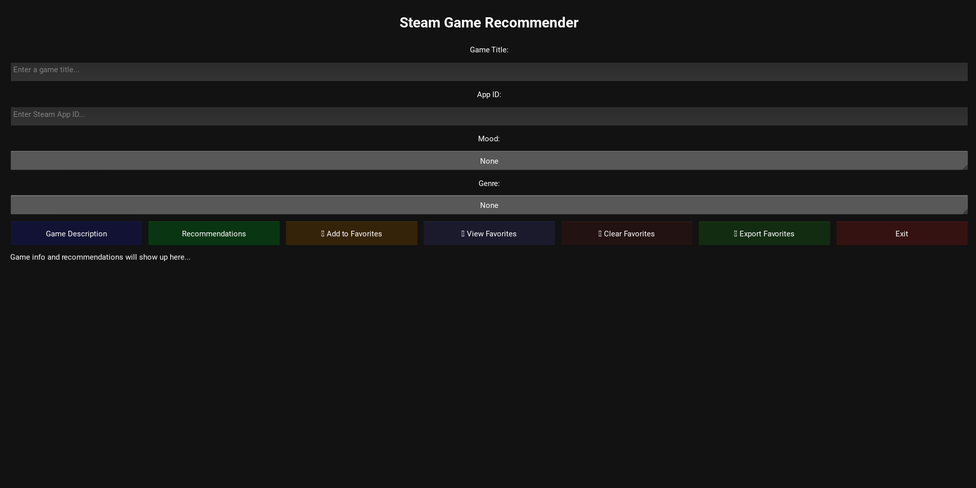
SNEAK PEEK

Slide 11

DEMO

Slide 12
What We Learned
06
How to merge and clean large datasets from multiple sources.
Writing logic to assign genres and moods when the data isn’t clean.
How to build and save a working ML recommendation model.
Building a real-time, scrollable UI using Kivy.
Improving search flexibility by allowing both title and App ID lookups.

Slide 13
Challenges We Faced:
Matching Titles Across Datasets
Kivy UI Errors
Incomplete and Messy Data
Running Our Work Successfully
Improving Search Flexibility

Slide 14
Future Improvements
Steam API Integration for live game data
Add game screenshots and trailers to the UI.
Add charts/visuals to show popularity or genre distribution.
Enhance mood classification using sentiment analysis or transformer-based NLP models.

Slide 15

Thank you!!!

